Slide 1
Yan Zhang’s
Data Analytics Portfolio

Slide 2
List of Projects
Māori Language Immersion in New Zealand Schools
RockBuster Stealth LLC Marketing Transition Analysis
Instacart Grocery Market Analysis
Preparing for Flu Season
Structured Topic Modelling of China’s TVET Assessment Policy
GameCo Global Video Game Sales

Slide 3



Project 1: Māori Language Immersion in New Zealand Schools
Sourcing open data
Exploring relationships
Geographical visualisations
Supervised maching learning
Unsupervised machine learning
Time series analysis
Tools:

Slide 4
Introduction
This project examines how Māori language immersion education, aimed at both linguistic and cultural revitalisation, is implemented across New Zealand schools to inform education policy.
  How is Māori language immersion distributed spatially?
  Is immersion participation associated with ethnicity or socio-economic context (School Decile)?
  Identify immersion archetypes based on ethnicity and school decile
  Māori immersion growth over time
Data Source
  New Zealand government official website, School Rolls by School (2010–2024)
Data Limitations
  Because the dataset is aggregated at the school level, it cannot support individual-level or causal analysis.

Slide 5
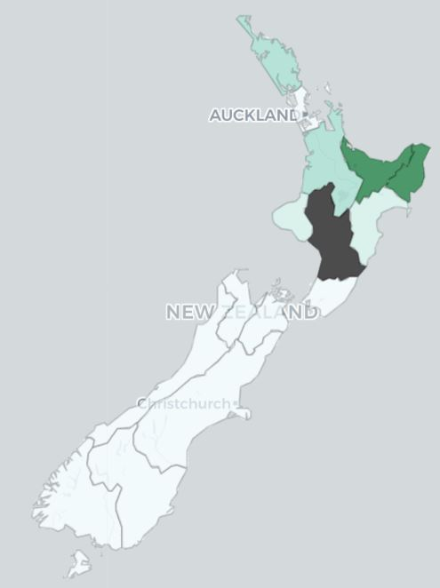
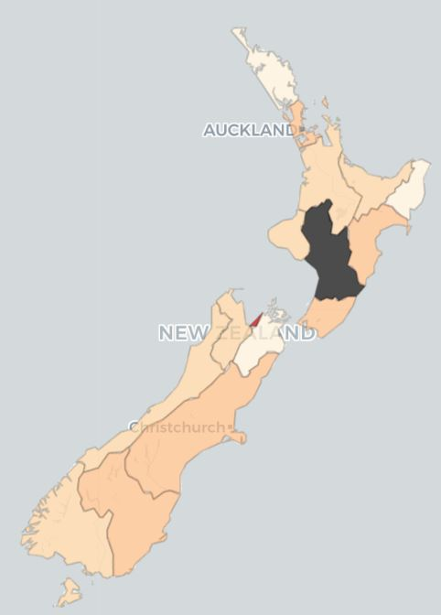

Immersion across NZ Regions
Regions such as Gisborne and Bay of Plenty show higher coverage of Level 1 Māori language immersion. In contrast, non-immersion is more prevalent across the country.
High Immersion Area
Low Immersion Area
Click to view the interactive maps

Slide 6
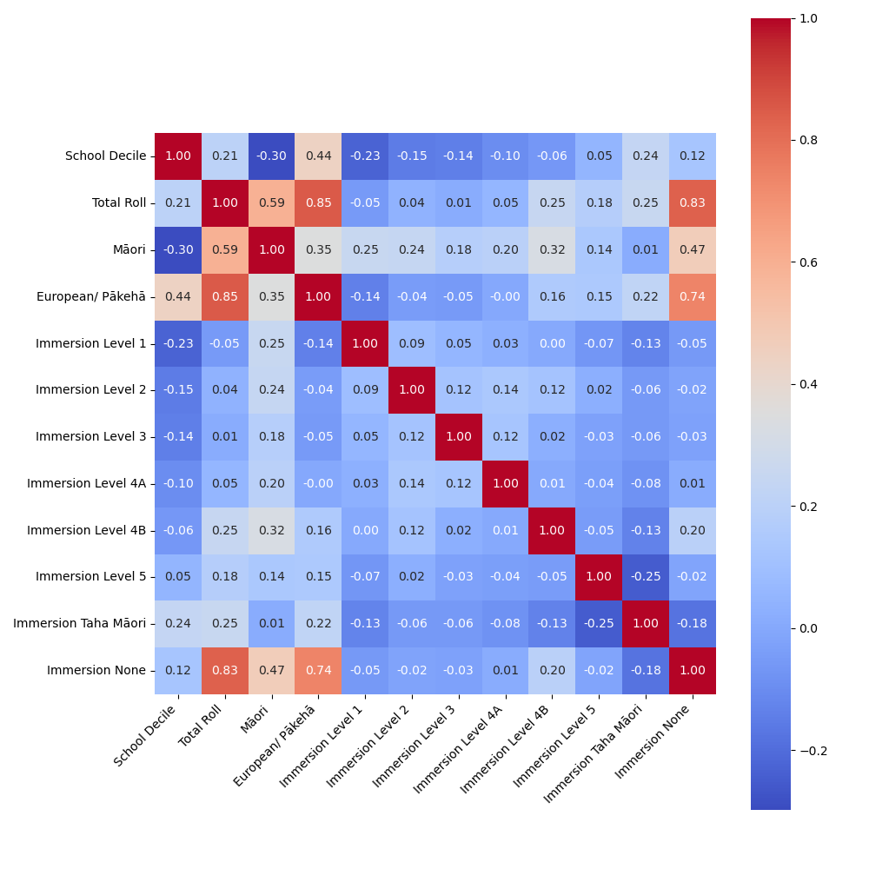
Correlations
The variables of school decile, ethnicity, and Māori language immersion show different range of correlations.
  Immersion None aligns with European/Pākehā (r = 0.74).
  This suggests that schools with a higher proportion of European/Pākehā students tend to have fewer students enrolled in Māori language immersion programmes.

Slide 7
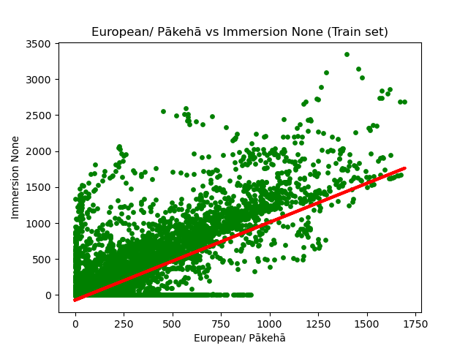
Supervised Machine Learning – Regression
European/Pākehā (%) is a strong predictor of Immersion None (%), explaining 56% of the variance (R² = 0.546, moderate fit).
This suggests that schools with higher European/Pākehā populations tend to have lower Māori immersion participation, revealing a demographic disparity.
The strong correlation between the two variables also suggests potential multicollinearity, which should be considered in further modelling.

Slide 8
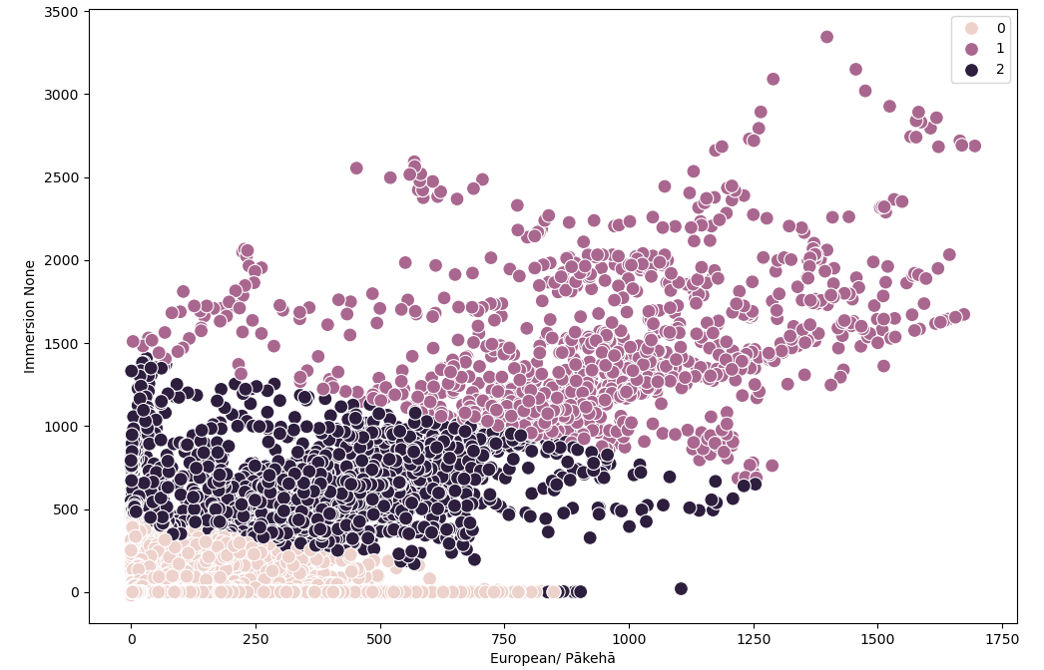
Unsupervised Machine Learning – Clustering
Purple Cluster
  High-Decile, European/Pākehā-Dominant
Dark Purple Cluster
  Mid-Decile, Mixed Composition
Pink Cluster
  Low-Decile, Higher Māori Immersion

Slide 9
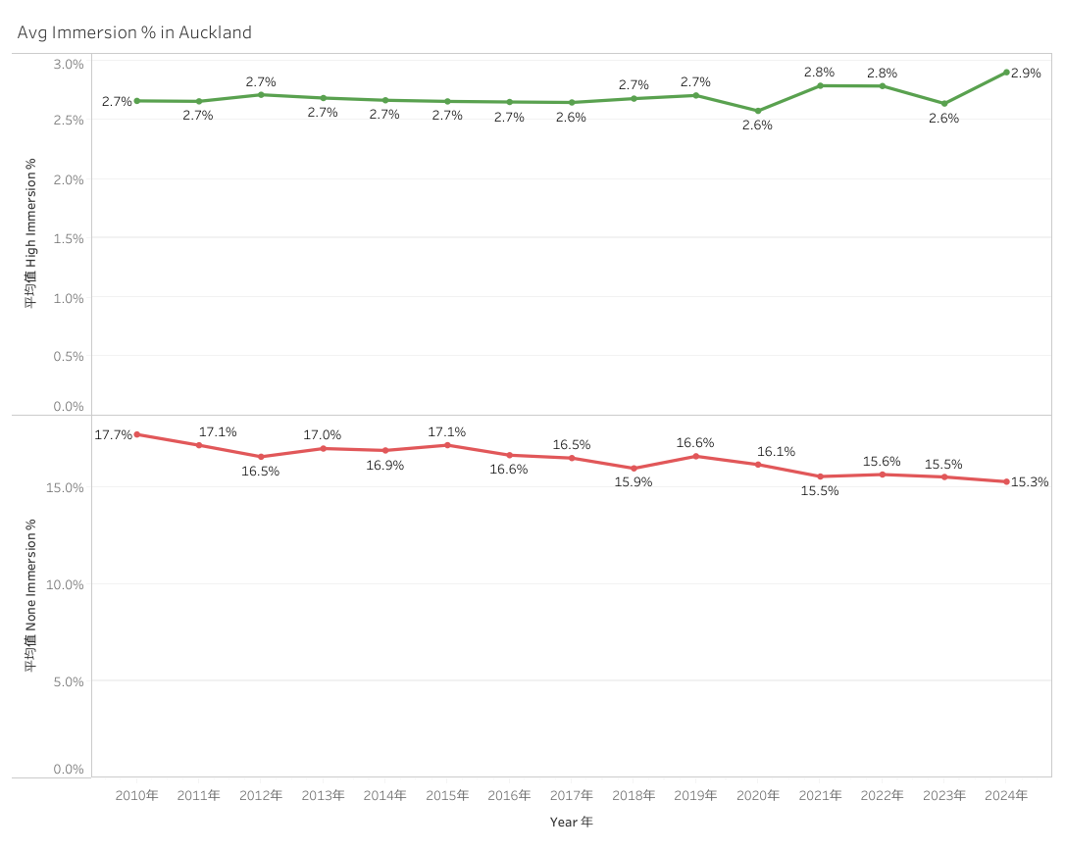
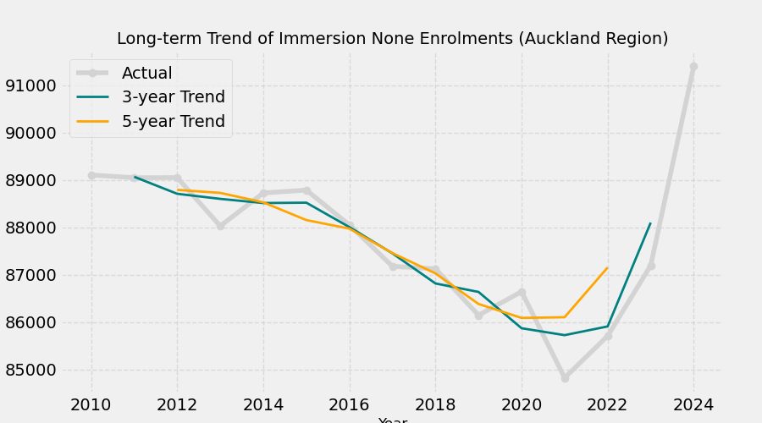
Time Series
Auckland: Gradual improvement but still low immersion participation.

Slide 10

Conclusion
Findings:
  High-Decile European/Pākehā schools show low participation.
  Māori immersion is strongest in low-decile, Māori-majority schools.
  Auckland shows gradual growth; Bay of Plenty maintains high immersion rates.
Recommendations:
  Expand Māori-medium options in high-decile areas.
  Strengthen iwi–school partnerships to support te reo Māori.
  Provide teacher training in Māori language and pedagogy.
  Monitor participation by region and decile to ensure equity and progress.
GitHub Repository
Tableau Dashboard

Slide 11


Project 2: Rockbuster Stealth
Marketing Transition Analysis
Data storage and structure
Summarising and cleaning data
Filtering data
Joining tables
Subqueries and CTE
Presenting results
Tools:

Slide 12
Introduction
Context
  Rockbuster Stealth LLC is a movie rental company that used to have stores around the world. Facing stiff competition from streaming services, it is planning to launch an online video rental service in order to stay competitive.
Questions:
  Which countries are Rockbuster customers based in?
  Which movies contributed the most/least to revenue gain?
  What was the average rental duration for all videos?
  Where are customers with a high lifetime value based?
  Do sales figures vary between geographic regions?
Data
  Rockbuster internal records (films, rentals, customers, payments)

Slide 13
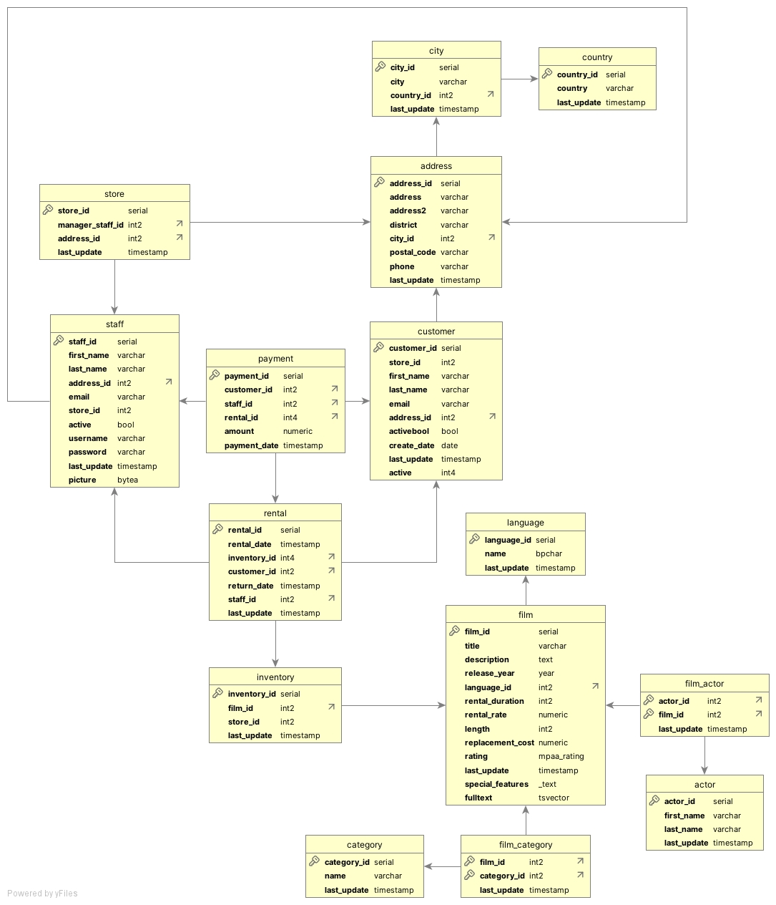
Entity Relationship Diagram
The Rockbuster database have a snowflake schema with two fact tables (payment and rental) and multiple related dimension tables
Notes:
(actor, address, category, city, country, customer, film, film_actor, film_category, inventory, language, staff, store)

Slide 14
Descriptive Statistics of Data
The dataset includes 599 customers from 600 cities across 109 countries. It contains 1,000 films spanning 20 genres, generating a total revenue of $61,312.04.
 | Average | Maximum | Minimum
Rental Duration (Day) | 5 | 7 | 3
Rental Rate ($) | 3 | 5 | 1
Length(Min) | 115 | 185 | 46
Replacement Cost ($) | 10 | 30 | 20

Slide 15
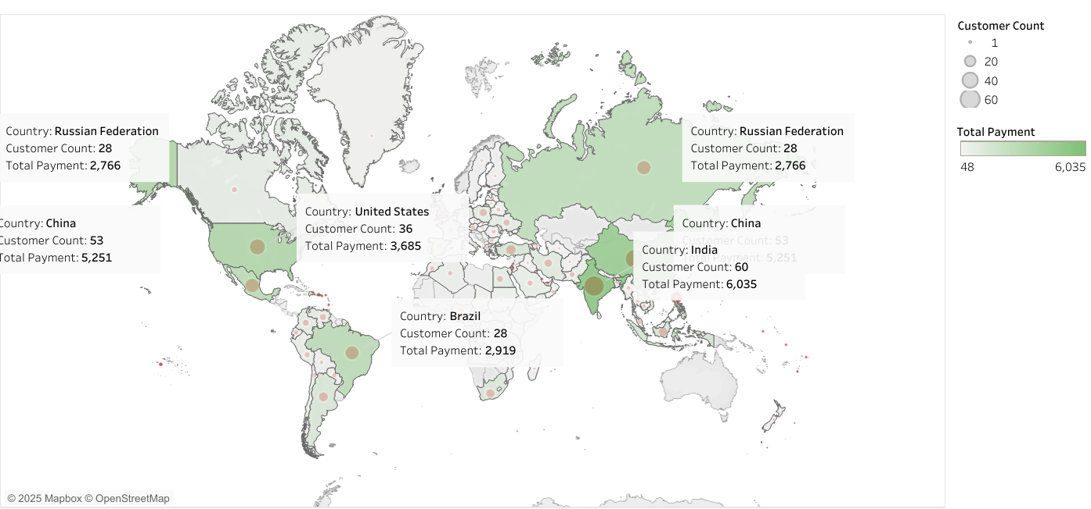
Distribution of Customers
India and China had the largest customer bases, followed by the United States, Japan, Mexico, Brazil, Russia, the Philippines, and Turkey.

Slide 16
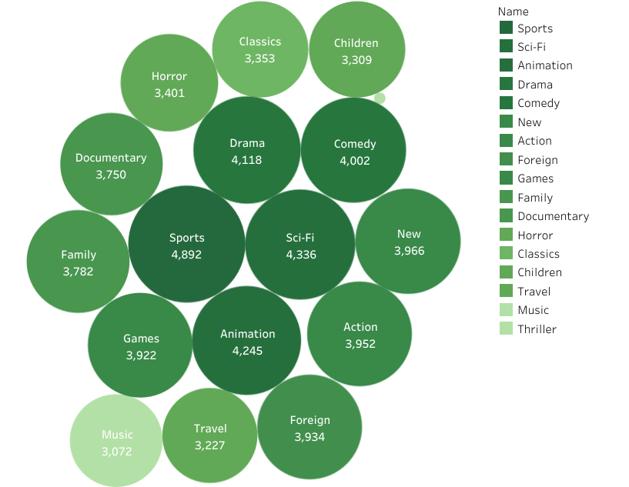
Revenue by Genre
Globally, the Sports, Sci-Fi, and Animation genres were the most profitable, whereas Children, Music, and Thriller generated the lowest revenues.

Slide 17
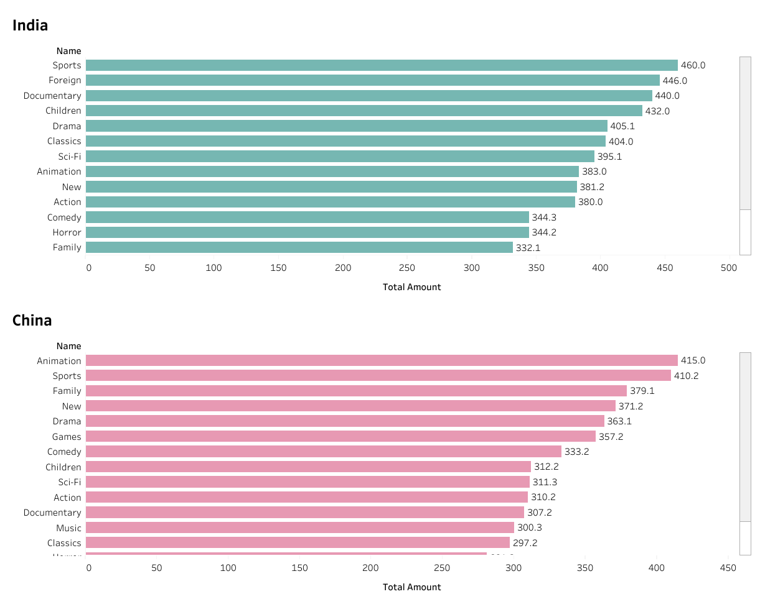
India vs China Revenue by Genre
Documentary and Children genres attracted 440.0 and 432.0 in India, while they generated only 307.2 and 312.2 in China.
In contrast, the Family genre performed better in China with 379.1, compared to just 332.1 in India.

Slide 18
Conclusions
Findings
  India and China dominate the customer base and revenue, with India generating the most.
  Sports, Sci-Fi, and Animation are the top-earning genres, while Children, Music, and Thriller underperform.
  Regional differences matter: India favours Documentary/Children, while China favours Family.
Recommendations
  Focus on India & China with tailored content and localized marketing.
  Prioritize high-performing genres (Sports, Sci-Fi, Animation) to drive revenue.
  Reassess low-performing genres and adapt strategies by region.
  Tableau Storyboard
  GitHub Repository

Slide 19


Project 3:
Instacart Grocery
Market Analysis
Data consistency checks
Combining and exporting data
Deriving new variables
Grouping data and aggregating variables
Merging dataframes
Data visualisations
Tools:

Slide 20
Introduction
Context
  Instacart, an online grocery store that operates through an app. Instacart already has very good sales, but they want to uncover more information about their sales patterns.
Objectives
  Identify busiest days and hours, overall spending patterns, and popular product categories.
  Uncover key patterns in Instacart customers’ purchasing behaviour to support data-driven marketing and sales decisions.
  Segment customers by loyalty, region, age, income, and family status to understand diverse purchasing habits.
Data
  Accessed from Kaggle.

Slide 21
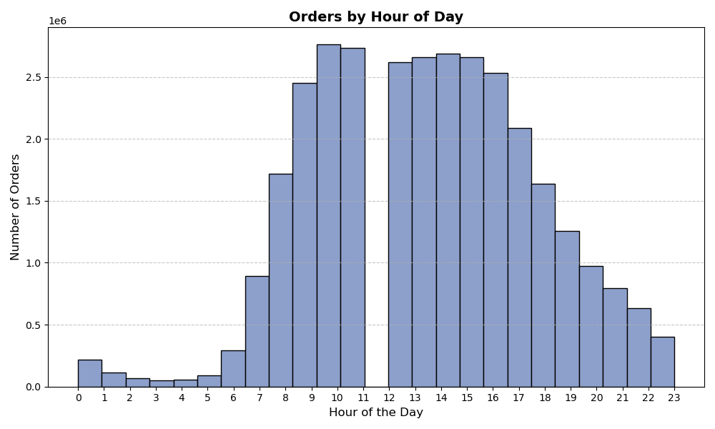
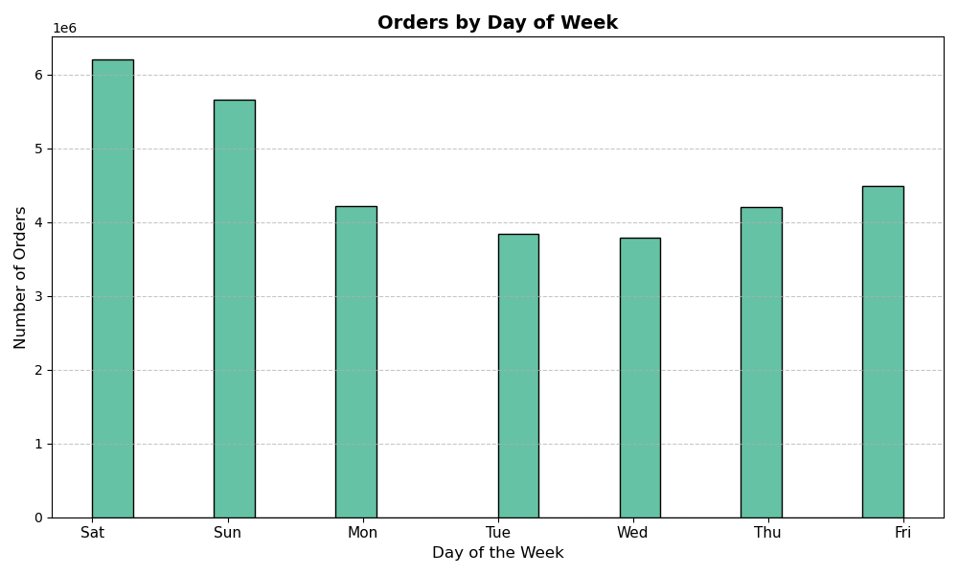
Order Numbers by Hour and Day
Most orders were placed between 9:00 a.m. and 5:00 p.m., whereas order activity was minimal between midnight and 6:00 a.m.
Orders peaked on Saturday and Sunday, while Tuesday and Wednesday were the quietest days.

Slide 22
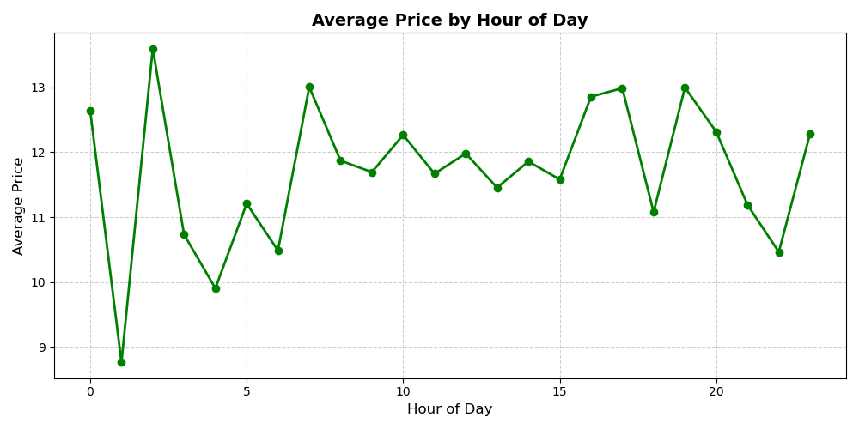
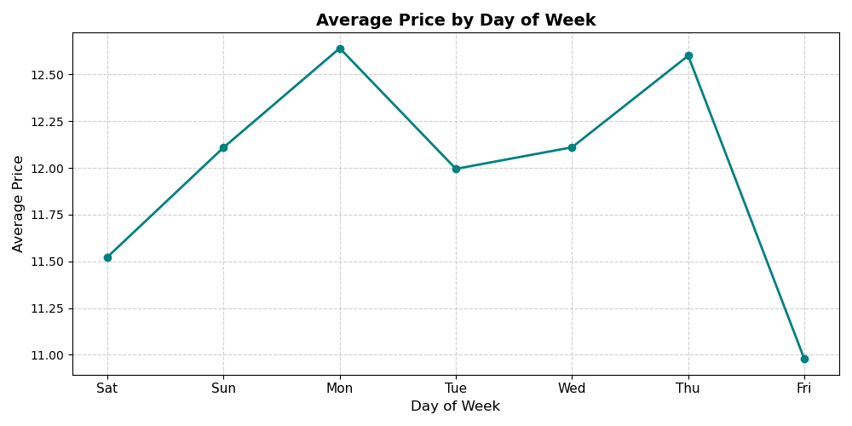
Spending by Hour and Day
Average spending peaked at approximately 3:00 a.m. and reached their lowest point around 1:00 a.m..
Average spending peaked on Monday and reached their lowest point on Friday.
Notes:
Between 8:00 a.m. and 3:00 p.m., Average spending remained relatively stable.

Slide 23
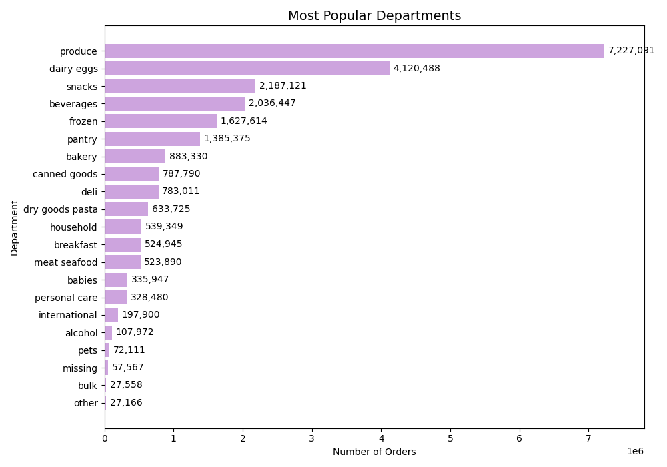
Order Numbers by Department
Produce, dairy eggs, snacks, beverages, frozen, and pantry were the most popular departments.

Slide 24
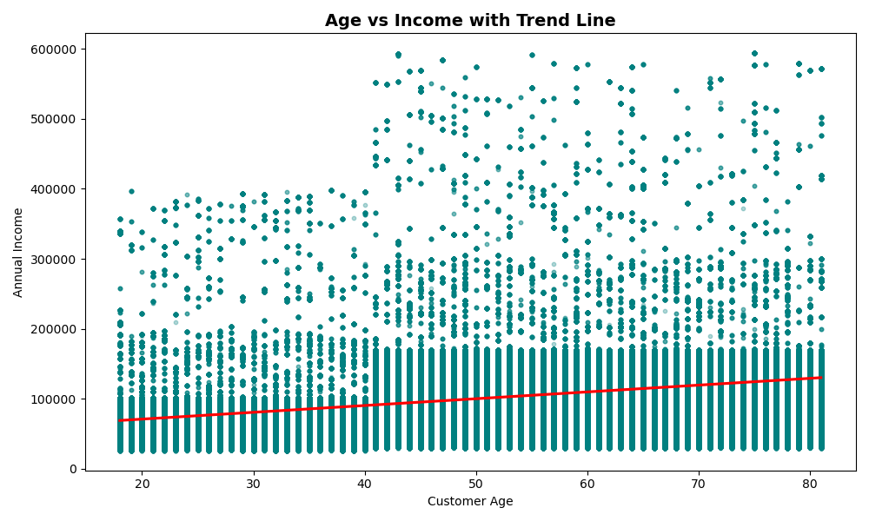
Income vs Age
Income grew gradually with age.

Slide 25
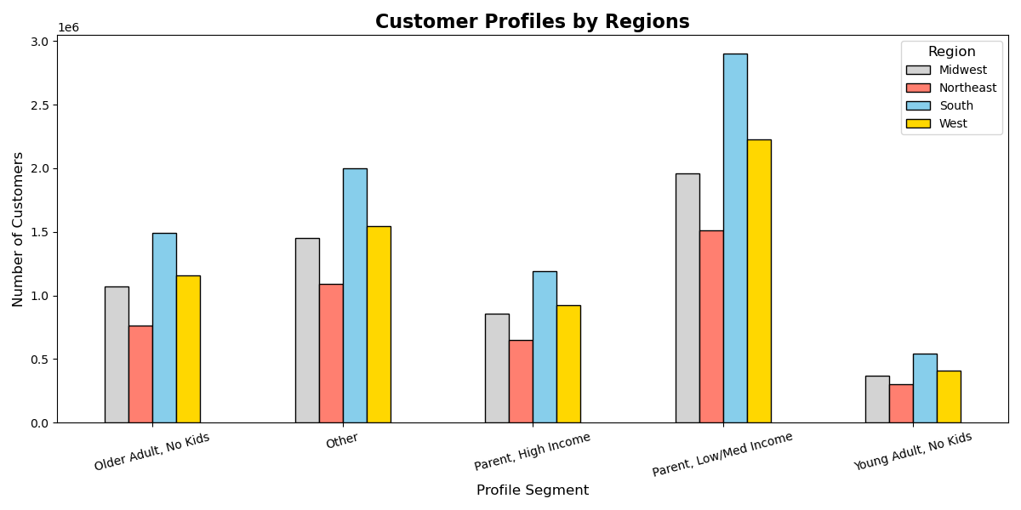
Customer Profiles by Region
Most customers were located in the South, followed by the West, Midwest, and Northeast.
Low- and medium-income parents were the most frequent shoppers, followed by parents with one child.
Notes:
Most customers were located in the South, followed by the West, Midwest, and Northeast. The distribution of customer profiles was relatively consistent across regions.
Low- and medium-income parents were the most frequent shoppers, followed by parents with one child, while young adults without children shopped the least often.

Slide 26
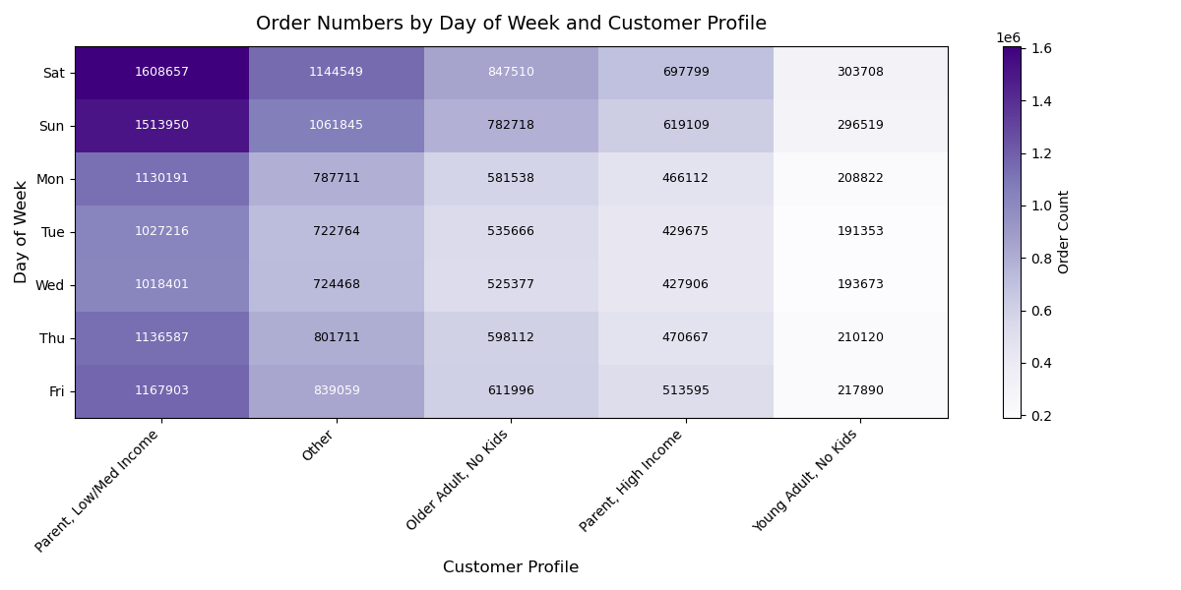
Order Numbers by Day and Customer Profile
GitHub Repository
Most orders were placed at weekends by low- and medium-income parents.
In contrast, Tuesdays and Wednesdays saw the fewest orders across all customer profiles.
Notes:
Most orders were placed on Saturdays and Sundays by low- and medium-income parents.
In contrast, Tuesdays and Wednesdays saw the fewest orders across all customer profiles.

Slide 27
Conclusions
Findings
  Orders peak on weekends and drop midweek (Tues & Wed).
  Spending fluctuates between 3 PM–10 PM, with Fridays showing the lowest activity.
  Produce, dairy, snacks, and pantry staples are the top-selling categories.
  Most customers are regular or new, mainly family-oriented, low- to medium-income parents.
Recommendations
  Schedule ads and promotions on slower days (Tues/Wed) and evenings (3–10 PM).
  Maintain strong inventory for high-demand staples.
  Introduce loyalty programs to retain and grow the customer base.
  Use family-focused, value-driven marketing and expand outreach in underrepresented regions.

Slide 28


Project 4: CDC
Preparing for the Flu Season
Data profiling and integrity
Data transformation and integration
Composition and comparison charts
Spatial analyses
Temporal visualisations and forecasting
Conducting statistical analyses
Tools:

Slide 29
Introduction
Objectives
  Identify the vulnerable age groups that are prone to flu deaths;
  Find out the states where vulnerable age groups are located;
  Determine the seasonal patterns of flu and see if that varies by state.
Data Overview
  US Census Data (2009 – 2017) from US Census Bureau
  Influenza Death Data (2009 – 2017) from Centres for Disease Control and Prevention (CDC)
Notes:
Context
Flu continues to be a significant threat to public health in the USA. A count of the historical flu deaths gives an indication of the severity of flu in an area.
Deaths can be prevented with flu shots and adequate medical staff. In the USA, each state has a different population composition, meaning that some states will have more vulnerable populations.

Slide 30
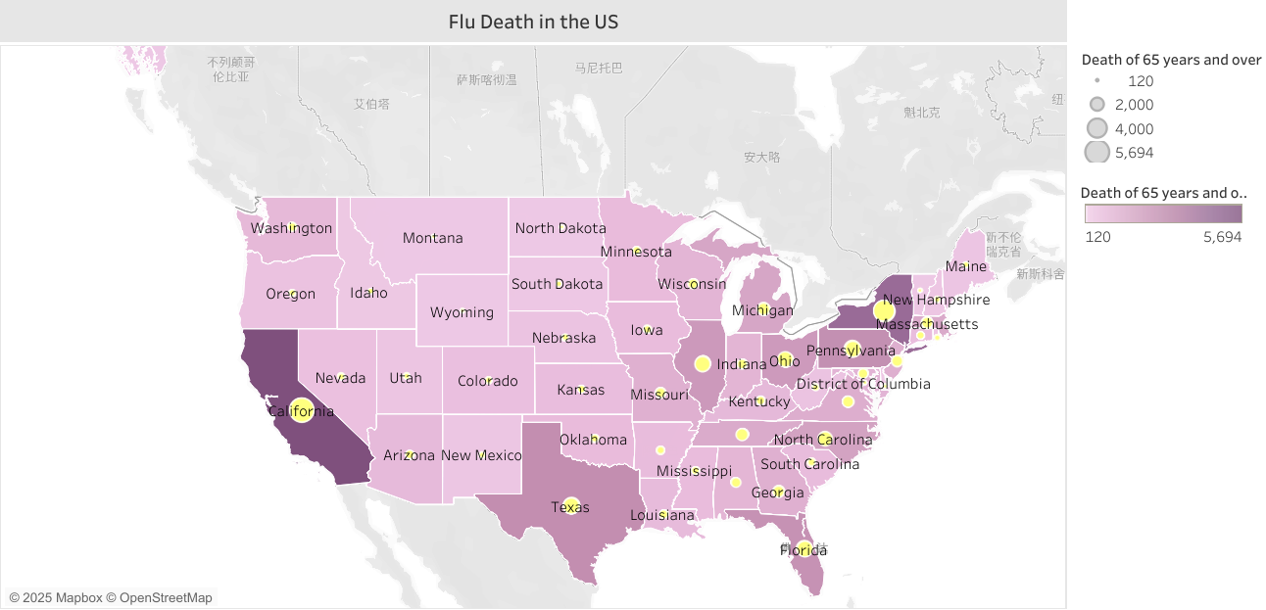
Distribution of Flu Death in US

Slide 31
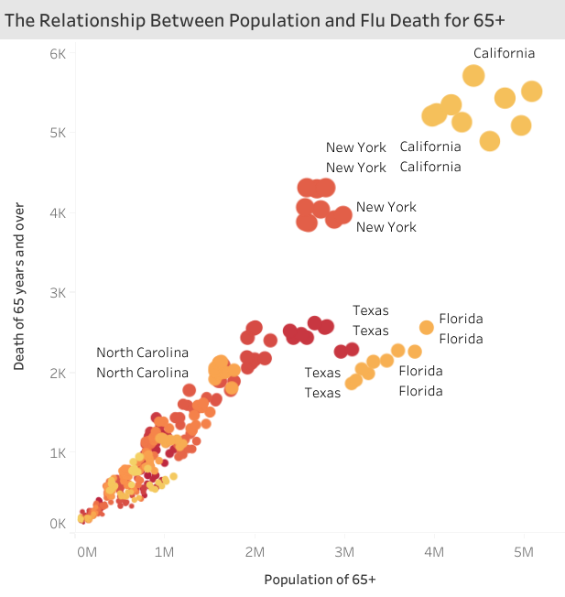
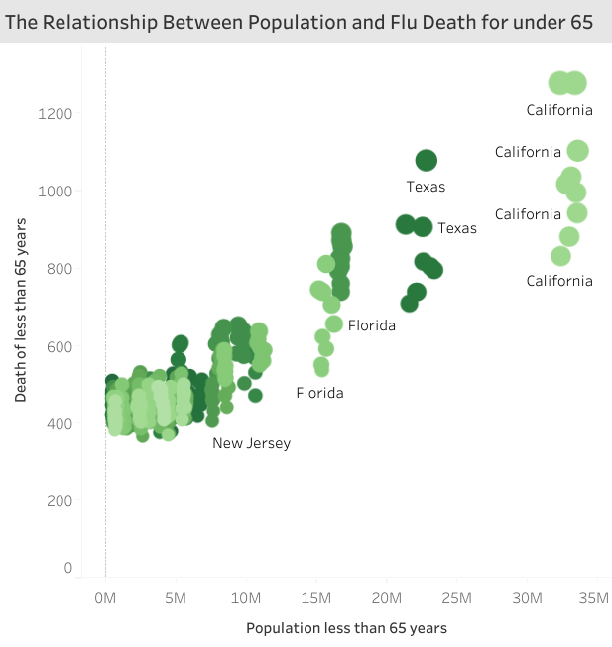
The Relationship between Population and Flu Deaths
There is a strong relationship between population size and flu deaths. The highest-risk areas are those with a large proportion of residents aged 65 and older.

Slide 32
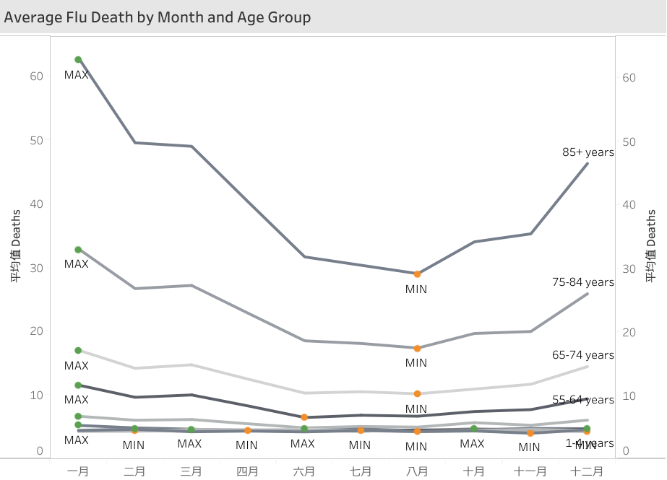
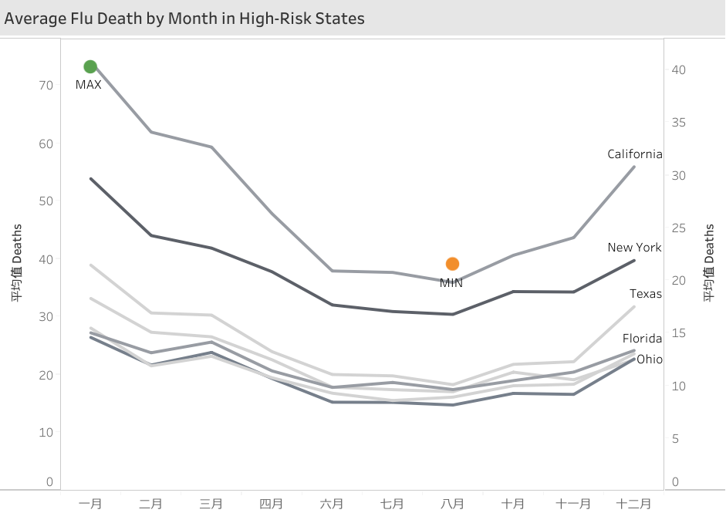
When is High Season?
December, January, February, and March were the peak seasons across states.

Slide 33
Conclusions
Findings
  65+ are much more vulnerable to flu deaths than younger populations.
  California, Florida , New York , Texas , Pennsylvania , Illinois, and Ohio had the largest 65+ population on average.
  Winter and early spring are the peak seasons for flu deaths.
Recommendations
  Targeted vaccination reminders particularly to individuals aged 65+
  Extra staffing and resource allocation in high-risk states
  Seasonal staffing planning beginning from October
Tableau Storyboard

Slide 34


Project 5: Structured Topic Modelling of China’s TVET Assessment Policy
Sourcing data
Data integration and profiling
Model validity checks
ANOVA on disciplinary differences
Model search and selection
Model inteterpretaion
Tools:

Slide 35
Introduction
Objectives
  This project demonstrates how Structural Topic Modelling (STM) can serve as a scalable alternative by modeling topics that vary with document-level metadata (e.g., discipline). We show end-to-end preprocessing, model search, quality evaluation, interpretation, and validation on a corpus of 166 policy documents.
Data
  Talent Development Plans from China’s tertiary vocational institutions

Slide 36
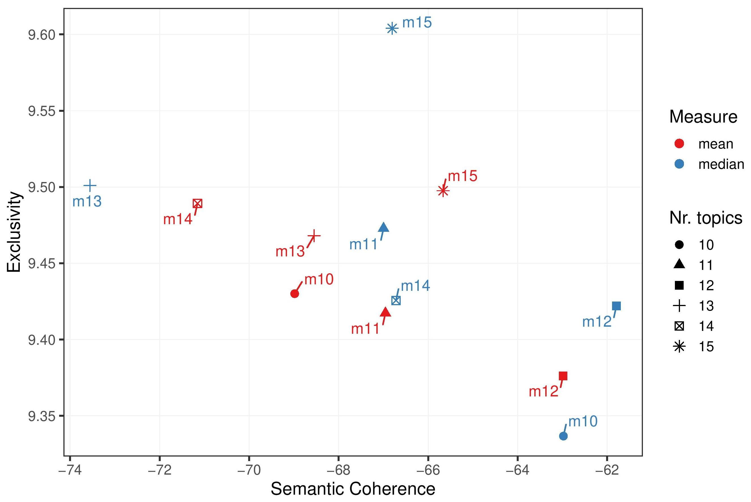
Model Search

Slide 37
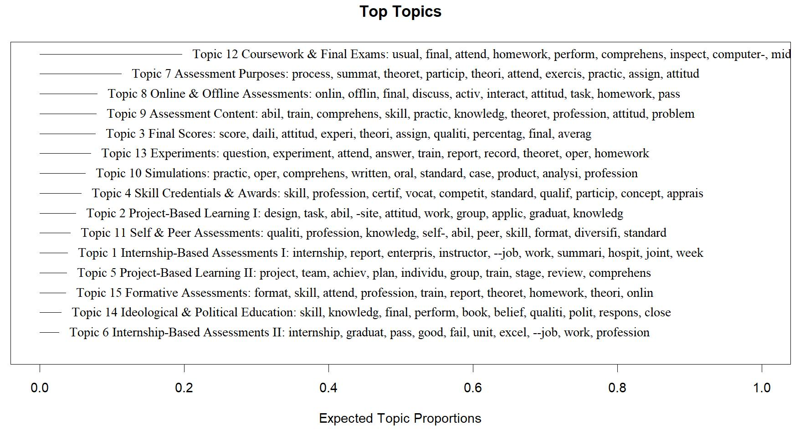
Topic Labels, Words and Proportions

Slide 38
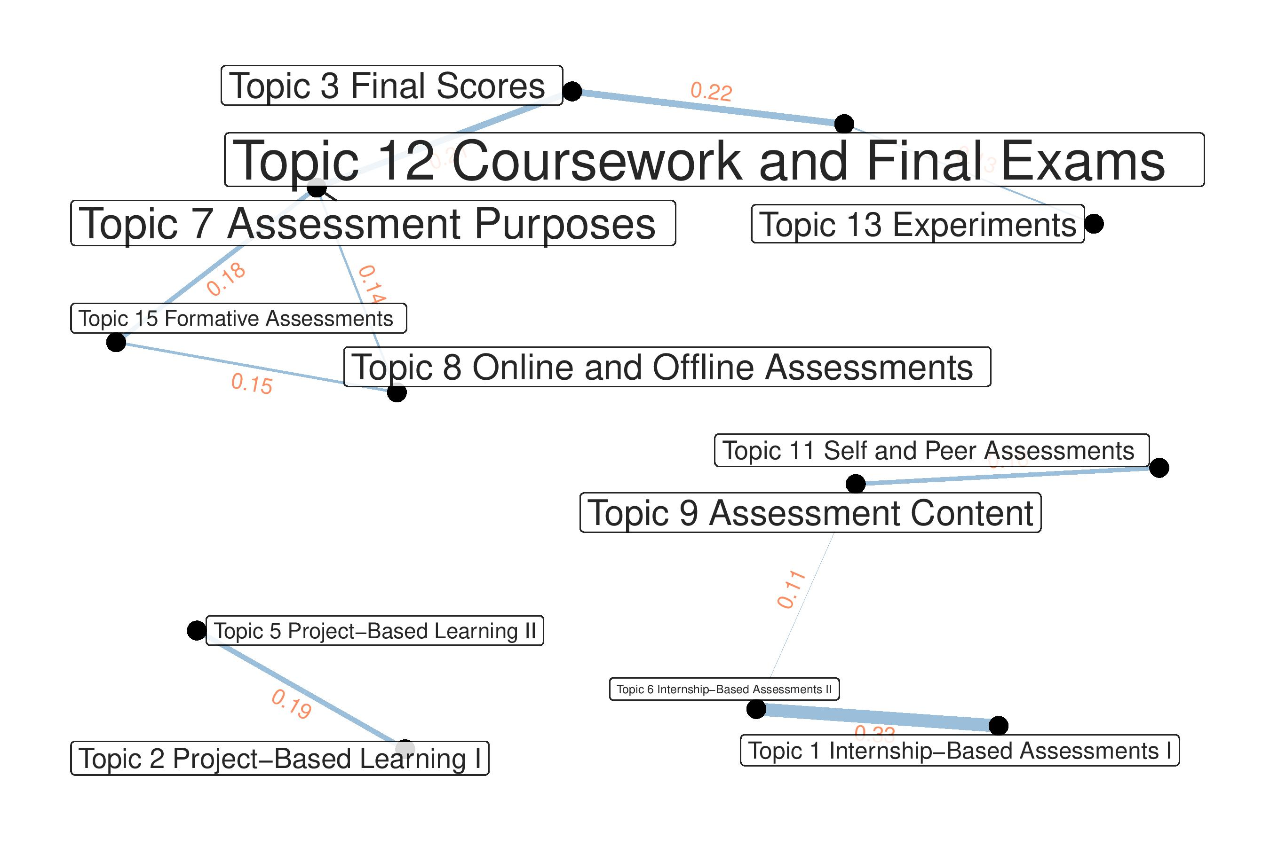
Topic Correlation

Slide 39
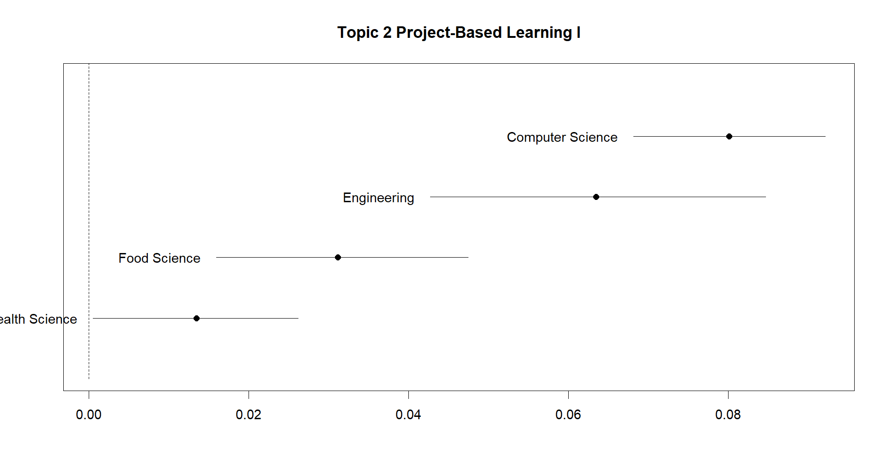
Topic 2 Document-Topic Proportion by Discipline

Slide 40
Conclusions
        .
Findings
  Common assessment types: Coursework, Exams, Projects, and Self/Peer Assessments.
  Discipline differences observed (e.g., Project Design in Computer Science).
  Formative assessments often overlap with summative grading, reducing feedback value.
Recommendations
  Diversify assessments: Blend exams, coursework, and applied tasks.
  Tailor to disciplines: Match formats with subject-specific practices.
  Clarify assessment purpose: Separate formative from summative to enhance learning impact.
GitHub Repository

Slide 41

Project 6:
GameCo Global Video Game Sales
Understanding data
Cleaning data
Conducting a descriptive analysis
Developing insights
Data visualisations
Grouping and summarising data
Tools:

Slide 42
Introduction
Context:
  A new video game company, GameCo, which wants to use data to inform the development of new games
Objectives:
  To find any difference in sales figures between geographic regions over time
  To identify the publishers that are likely be the main competitors in certain markets
  To understand the types of games that are more popular than others
  To find games that decreased or increased in popularity over time
Data Set:
  The data set was drawn from the website VGChartz.

Slide 43
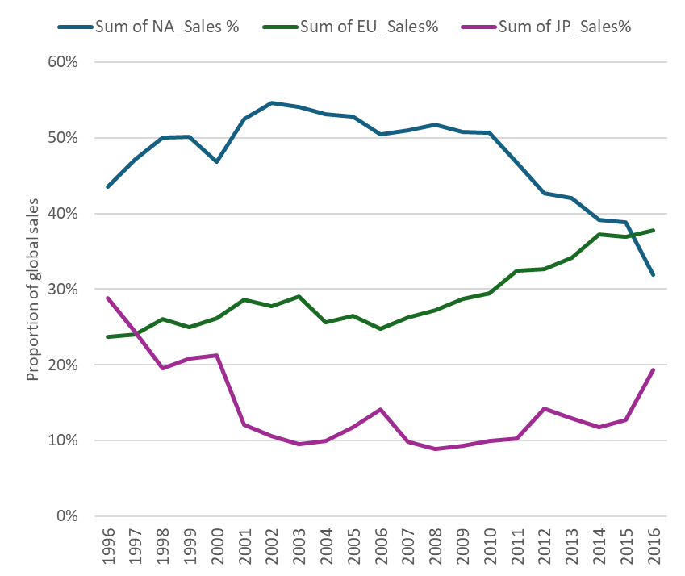
Sales between 1996 and 2016
North America > Europe > Japan

Slide 44
Genre: Nintendo in JP
Notes:
JP’s favourite genres were role-playing and action, which were much over other genres.
The biggest competitor in JP market, Nintendo, only accounted for 37% and 11% of role-playing and action, respectively.
There’s still market space for Gameco to seize.

Slide 45
Conclusions
Findings
  The JP market was promising than NA and EU, where the global sales percentage showed limited growth.
  There is still much market space for role-playing and action in addition to Nintendo’s share.
Recommendations
  Focus on the JP market, which shows strong growth potential and is less saturated by dominant competitors.
  Specialise in role-playing and action games, genres with room for growth.

Slide 46

Thank you!
Yan Zhang
📧 sancheungedu@outlook.com
📞 022-492-8823
GitHub
Tableau

